Slide 1
Readmission: a healthcare analysis
By: Anthony Pistocchi
Notes:
Title page notes

Slide 2
Agenda
Introduction
Objective
Methodology
Analysis
Conclusion and Recommendations
Q/A

Slide 3

Introduction
Background/Education: Graduated from Texas Tech University with a degree in Criminology with a minor in Forensics.
Nationally certified as an EMT and Firefighter.
Profession:
Assistant manager at a storage facility, volunteer at a fire station as well.
Fun Fact:
I was a competitive men’s gymnast for 11 years.
Notes:
Hello, my name is Anthony Pistocchi. Now about myself. I graduated from Texas Tech University with a bachelor’s degree in Criminology and a minor in forensics. I am also Nationally certified as an EMT and firefighter, with some experience as well. At the moment, I am working at a storage facility as an Assistant manager, and I volunteer as a fireman every now and then. A fun fact about myself is that I was a competitive gymnast for 11 years, and in the picture is my girlfriend Sarah and our dog.

Slide 4
Objective
The objective of this presentation is to help understand readmission rates.
Identify high risk patients, demographics, readmittance, and diabetes rates.
Notes:
The main objective of this presentation is to help understand the rate of readmission and show why readmissions happen. This can be done by identifying the high risk patients, demographics, readmittance, and diabetic rates throughout the analysis.

Slide 5

Methodology
Capstone 2 : diabetic_data.csv
101766 Rows, 50 Columns of data
No duplicates
Excel: Data explored, statistical summary, etc
SQL: Short statistical analysis, looking at numerics
Python : Data quality checks, full analysis
Tableau: Actual data visualizations
Notes:
The dataset that was provided for capstone two is called diabetic_data, it was originally a csv file. The data has 101766 rows and 50 columns, in which I have chosen to use 20 of the columns since most of the columns provided were what medications were provided for the patient. Insulin was the only medication column that I had chosen to keep in my analysis. This is because insulin is an important drug for diabetic patients. The data was organized with Excel and Python, mostly with Python code to see the stats and info. Using python I was able to find that there were no duplicates in the data, and there were 181,168 missing values. The missing values were not replaced because they were from columns I have chosen not to include in my analysis. Because this is patient data, a lot of information needs to be redacted such as patient name, address, and date of birth or of admission because it is a violation of HIPPA. The actual visualizations of this project were completed in Tableau, which will be shown in the following slides of the analysis.

Slide 6



The Analysis
Notes:
The fun part, the Analysis

Slide 7
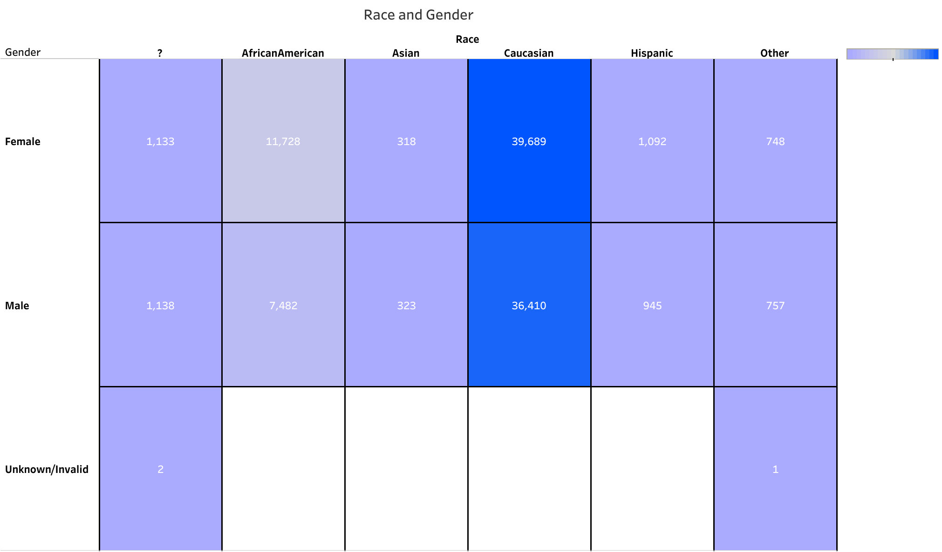
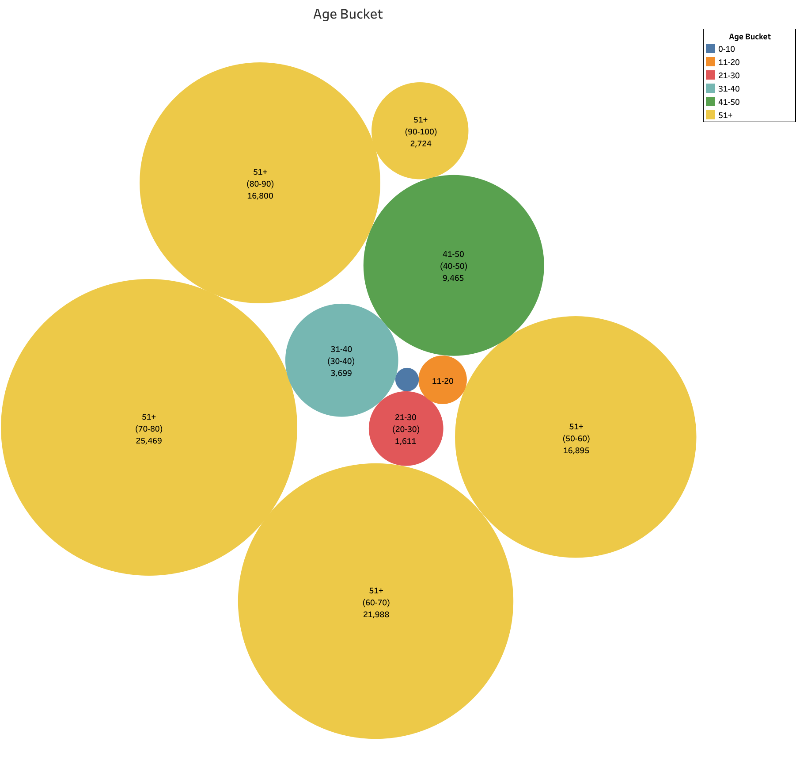
Demographics of the Patient
In the Age Bucket, the age bracket with the highest number of patients is 70-80 years of age at 25,469, with the lowest being 0-10 with 160 patients.
In the Race and Gender figure, Caucasian Females were the highest number of patients at 39,989, with Asian Females being at 318. Unknown and Invalid accounted for 2 patients
Notes:
The demographics of the patient are very important information for healthcare providers to obtain. This information is necessary for understanding the context of a patient's health and for providing personalized care. Demographic information, such as age, gender, race, etc, can help healthcare providers identify potential health risks, disparities, and trends within different populations. It also plays a key role in making accurate diagnoses, tailoring treatments, and developing effective prevention strategies.
For the Age bucket graph, I chose to show a circle map that shows the amount of patients who fell between certain 10 year brackets. As you can see, most patients are older than 51 years of age shown with the yellow circles, while the minority of patients were less than 11 years old shown with the blue circle.
Race and Gender of patients are detailed by the count of their admission in the hospital. Most patients were Caucasian and Female, with Caucasian Males behind them. The least amount of patients were Asian and Female. If you count the unknown or invalid gender and the other tab for race, that leaves 1-2 patients unknown or who chose not to disclose their information with healthcare providers.

Slide 8
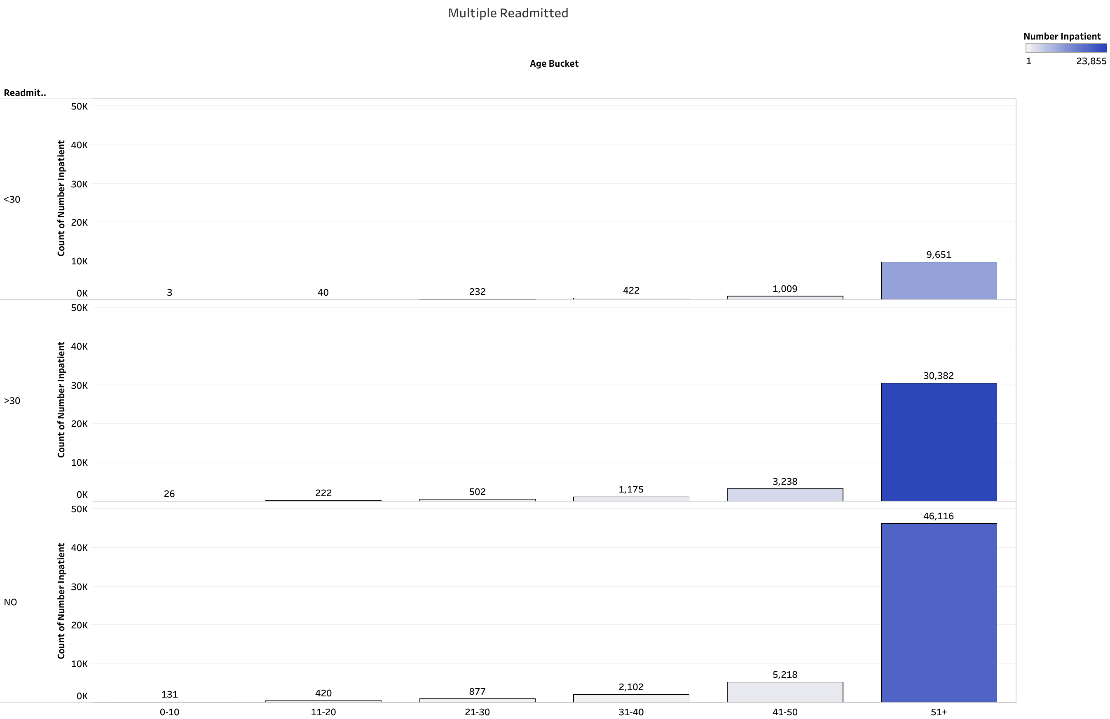
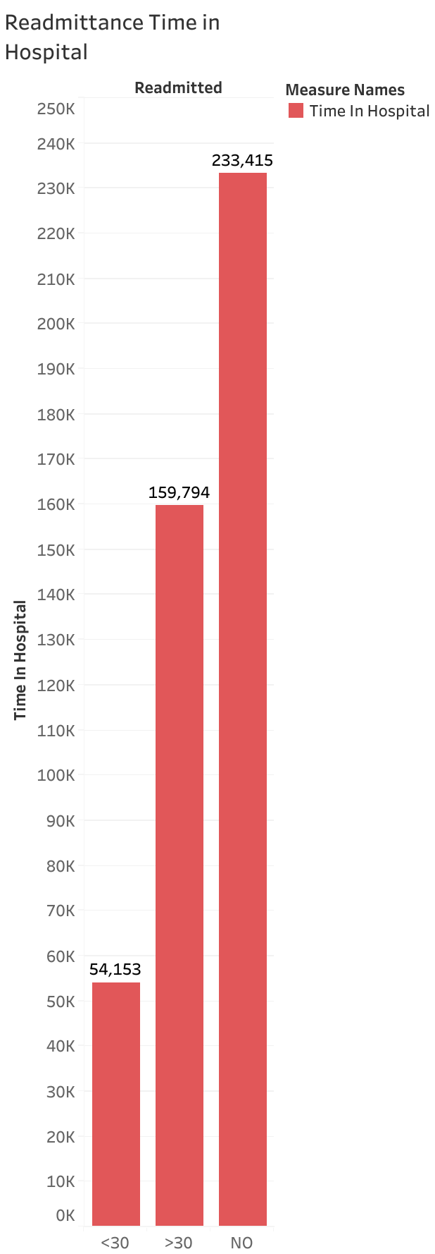
Readmittance of patients
Patients over the age of 51 years old who were not readmitted to the hospital are at 46,116 patients. Patients in the same age bracket who were readmitted over 30 days were counted at 30,382. The over 51 year old patients have the most admissions and readmissions throughout the chart.
Notes:
Readmittance of patient happens for many different reasons such as Complications or Recurrence of Condition, Infection, Medication Issues, Inadequate Discharge Planning, Mental Health or Social Issues, Delayed Recovery, etc.
In the first graph, The multiple patients that were readmitted were based off of their age bracket. To explain the readmission variables, <30 means that the patient was readmitted in less than 30 days of their first admission. >30 would mean the patient was readmitted in more than 30 days. Of course, the highest amount of patients readmitted in age were over 51 years old, with those patients being more likely to be readmitted to the hospital in over 30 days. The age bracket with the most admittance and readmittance is the 51 and up patients. The rest of the patients who were younger than 50 do not even come close to the amount of admissions from the 51 and up patients.
With the readmittance of patients in hospitals, the amount of time spent on these patients is shown in the second graph. The most amount of time is spent on patients who were not readmitted, with patients who were readmitted in both timeframes being almost the same value. The amount of time in days spent on patients who were readmitted is 213,947, just 19,000 short of the patients not readmitted. Almost half of the time spent on patients is of those who were readmitted.

Slide 9
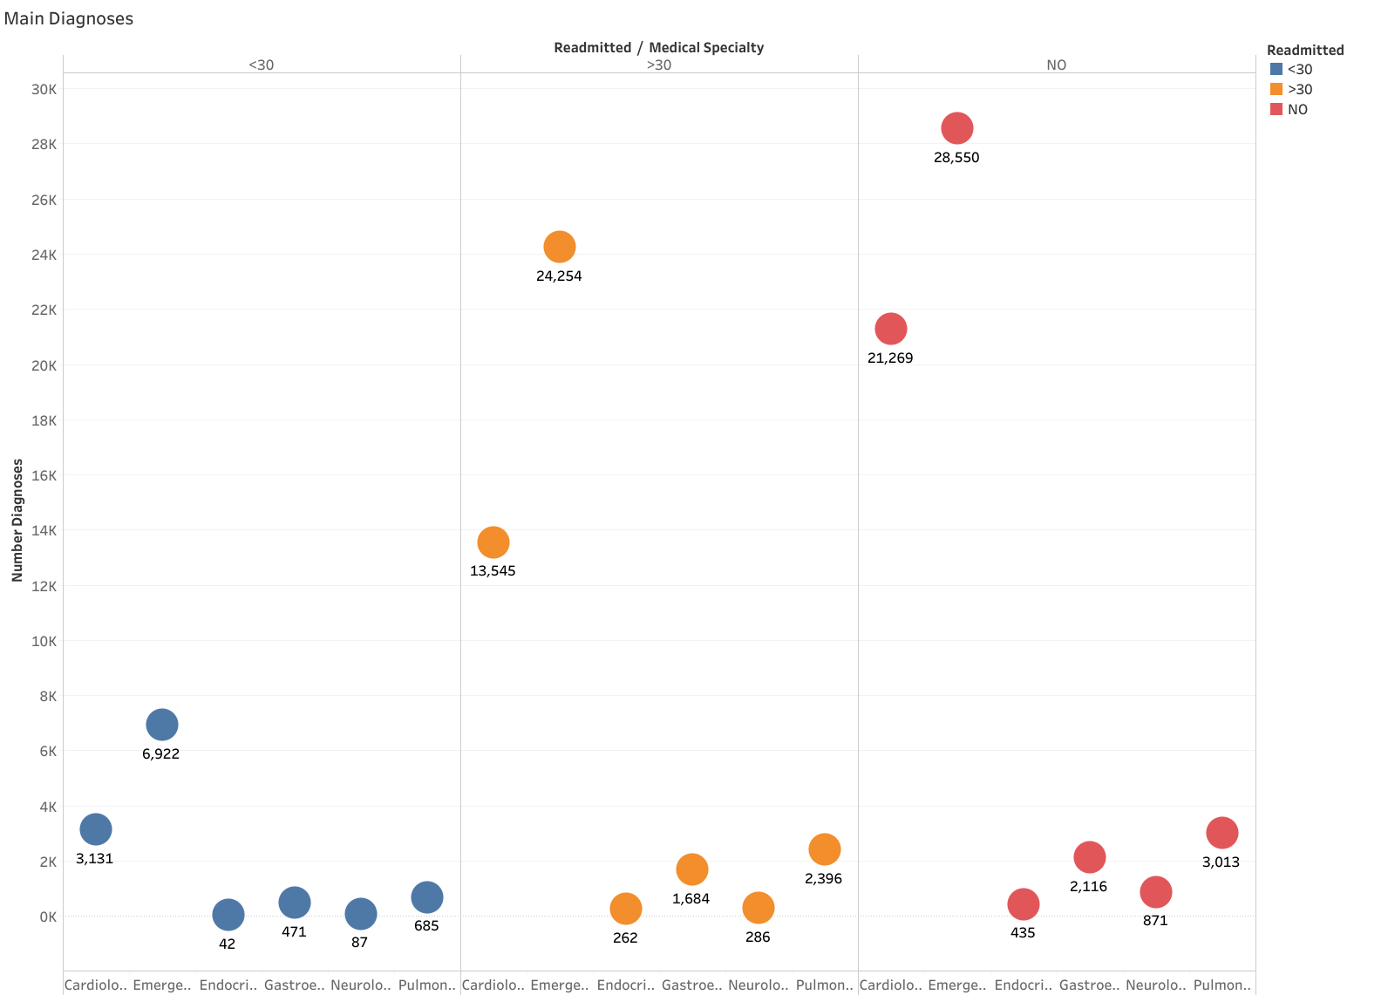
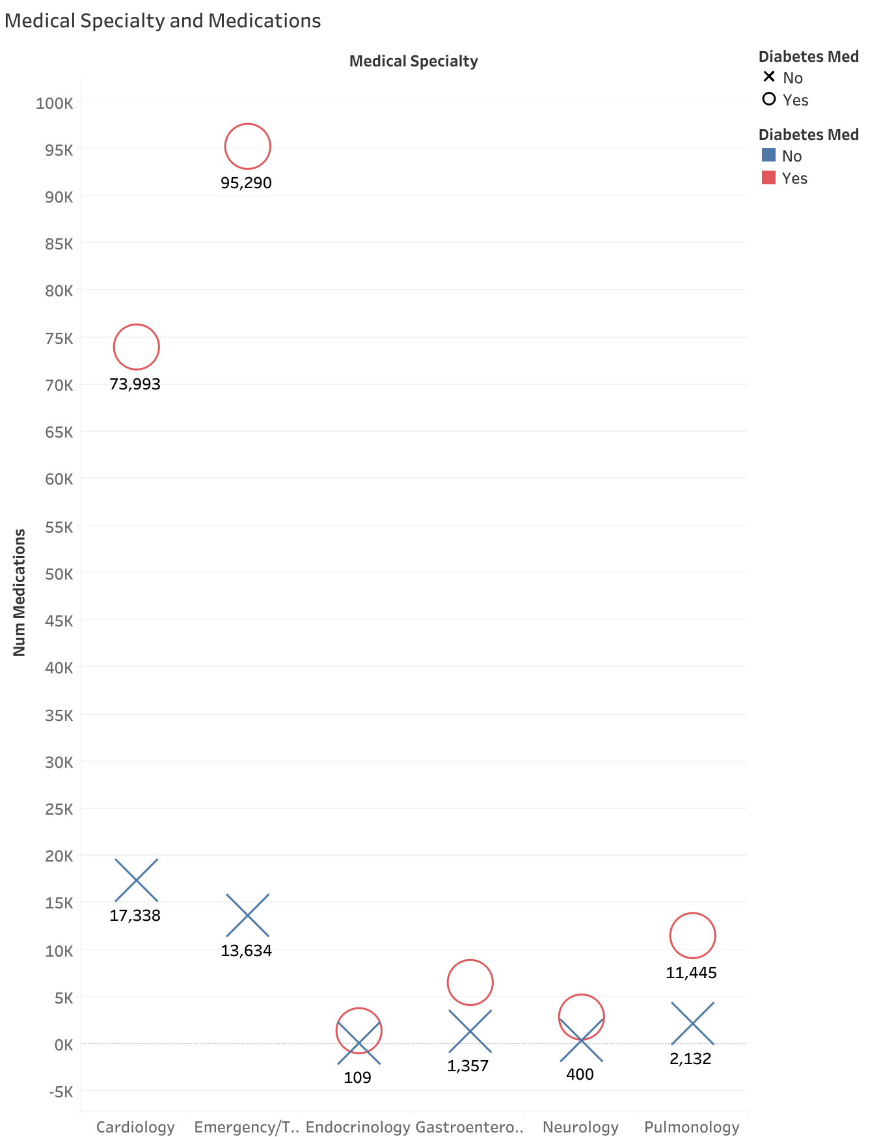
Medical Specialty
Notes:
The diagnosis of patients that were admitted are shown by their specialty of care provided from healthcare professionals. The highest number of specialties of care given to patients was emergency and trauma, with the lowest being endocrinology. The patients who were not readmitted were a big chunk of the patients in each medical specialty. With readmittance of these patients, the amount of patients who were readmitted in more than 30 days had a denser population when compared to patients in less than 30 days. If the 30 day bracket of readmittance is combined, the numbers are close or even more than patients who were not readmitted in some specialties such as emergency cases.
Taking a look at the amount of medications that were prescribed to patients per specialty, these are divided by diabetic patients that were given a diabetic medication. The diabetes medications are tracked by the shape of the plot point and their color, an X for no diabetic medications and a circle if that was a yes for diabetic medications. Emergency/Trauma patients had the most medications prescribed at 108,000, with over 95,000 of these medications being prescribed to patients who need diabetic medication prescribed. Looking at the trends, it shows that most of the medications were for diabetic patients who need a diabetic med in each medical specialty.

Slide 10
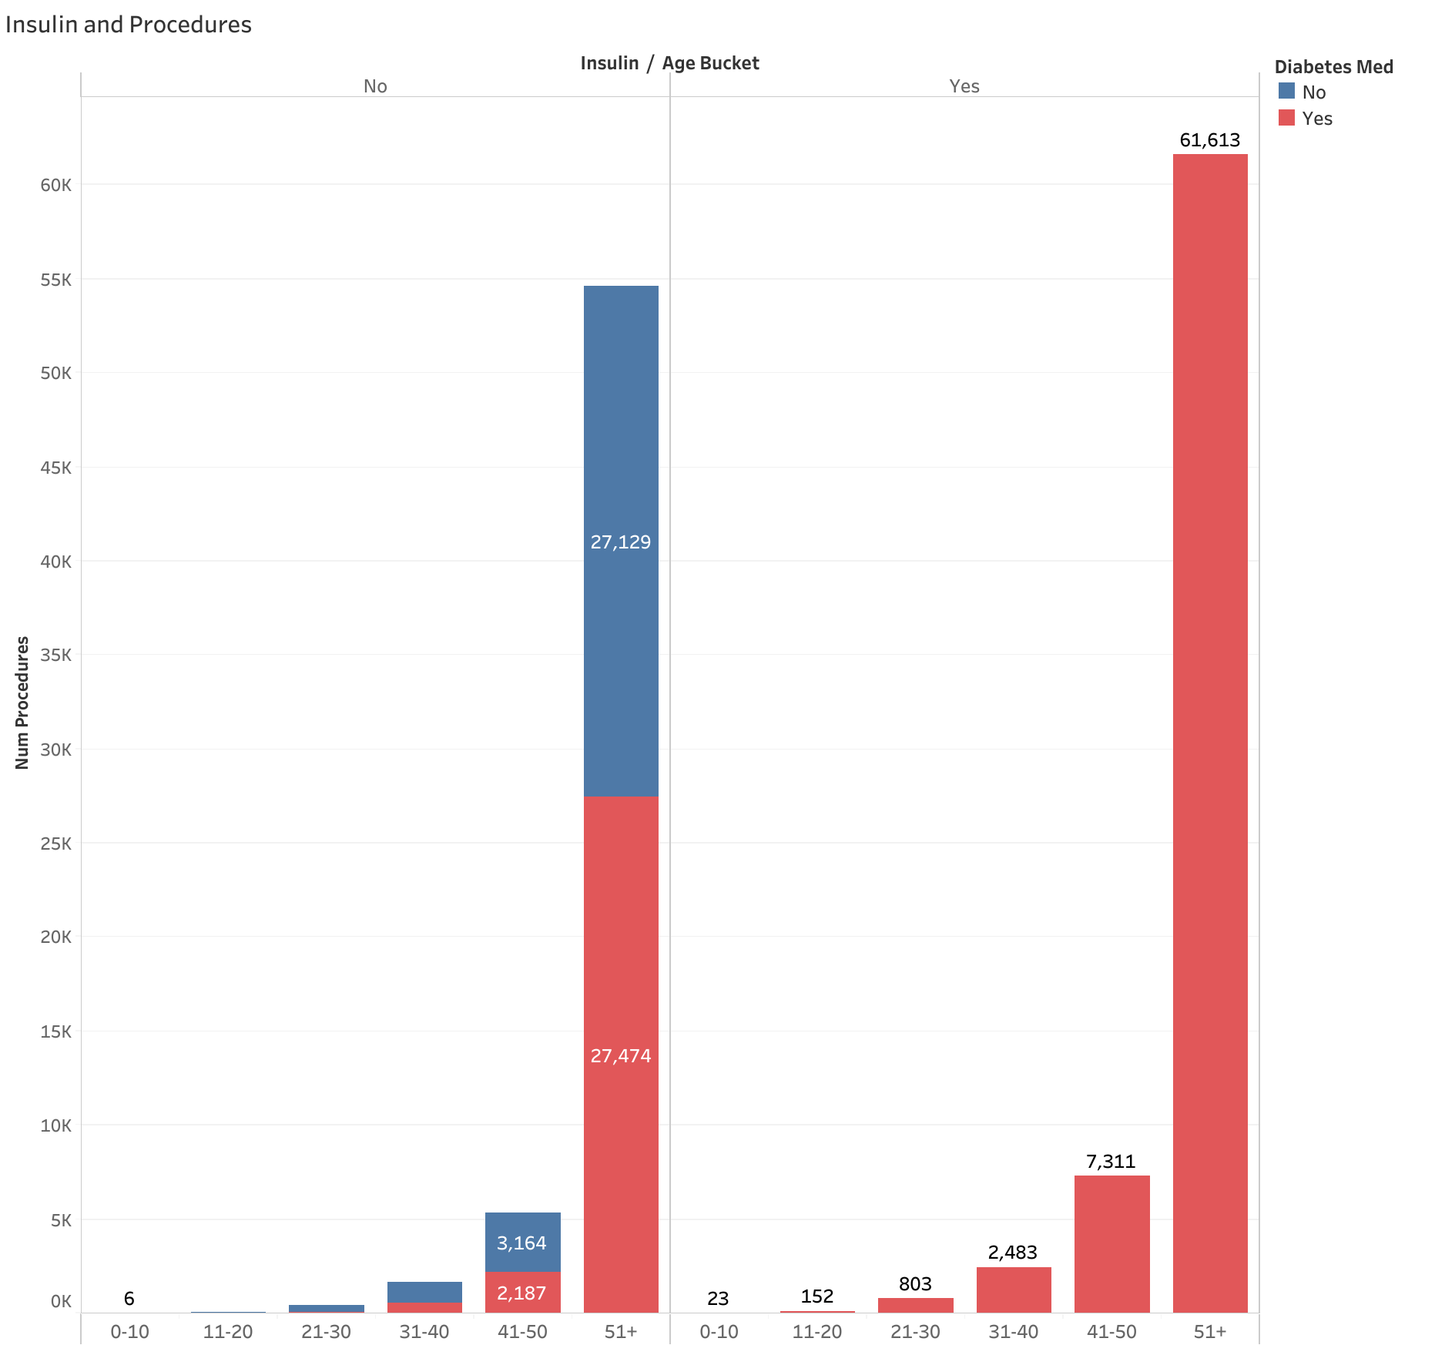
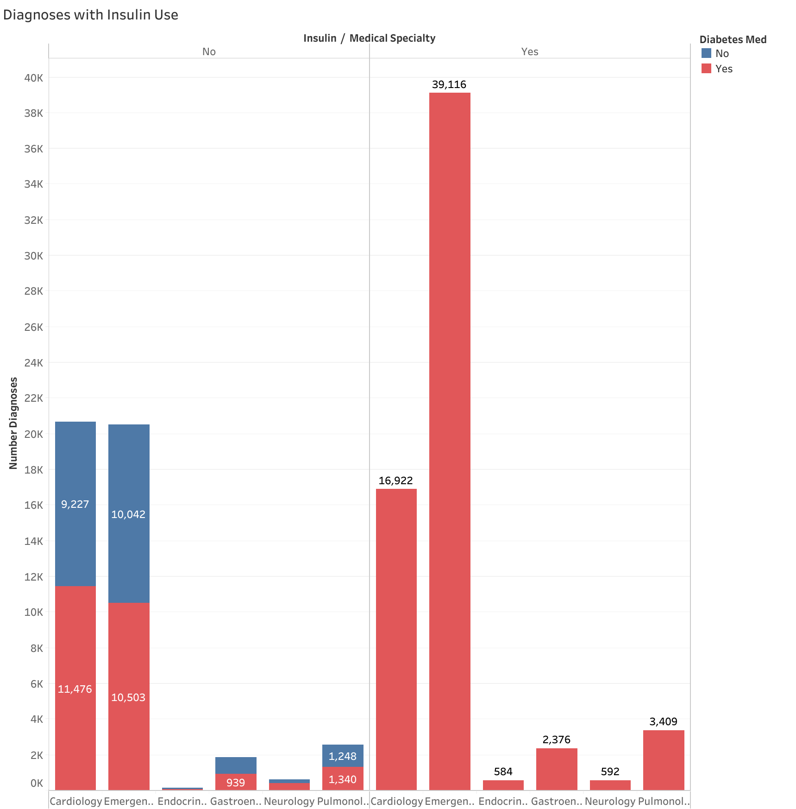
Diabetes and insulin
Notes:
I chose to include one of the medications in my final dataset, which is Insulin. This is because Diabetes is a very serious chronic condition that affects how the body processes blood sugar (glucose). If left unmanaged, it can lead to serious complications. Insulin is needed to help manage diabetes.
The insulin use of patients who had procedures was tracked by their age bracket and if they were or were not prescribed insulin. If patients were prescribed another diabetic medication that is not insulin, it is shown by red and blue colors for yes and no. Patients who were over the ages of 51 that were prescribed insulin have the most procedures done, with patients under 50 years old not having nearly as much procedures done. Even if patients were not prescribed insulin, a good population of them were prescribed other diabetic medications.
Taking a look at the specialty of care that patients who were prescribed to insulin were given, it shows that even if patients were not prescribed insulin, a great number of diagnoses happened with cardiology and emergency encounters. Patients who were prescribed insulin on the other hand were a large amount of the encounters in emergency/trauma. A very small amount of patients were in endocrinology, and a very small population were given any insulin.

Slide 11
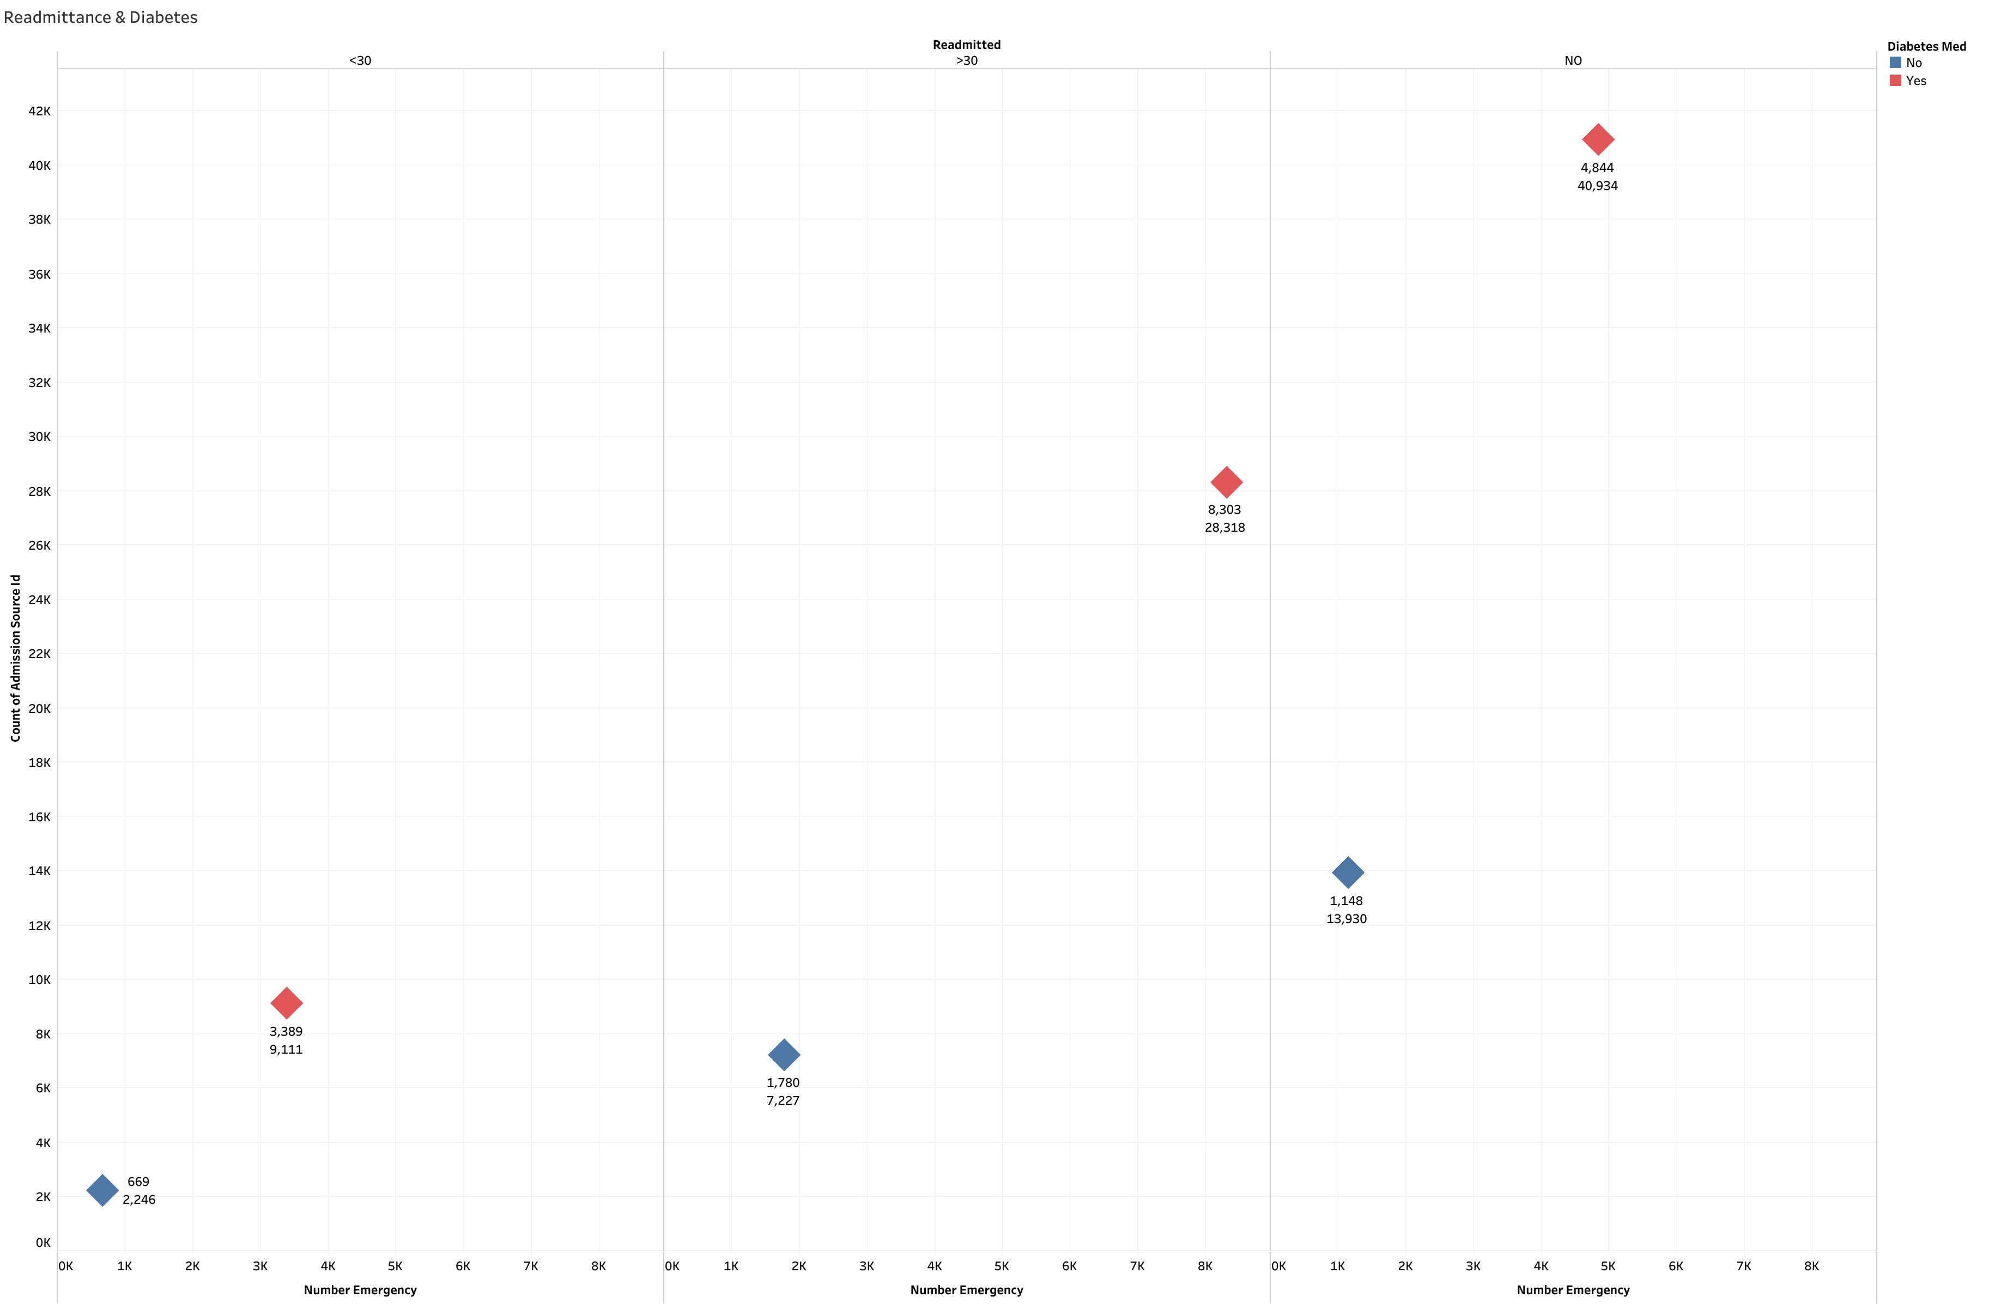
Readmittance & Diabetes
Almost half of the general admissions who have a diabetic medication have been readmitted. The amount of patients being readmitted in more than 30 days are at 28,318. 8,303 of those patients were admitted to the emergency room.
Notes:
The rates of readmittance are shown with all patients who have been admitted and the patients who were admitted to the emergency department. The numbers that are shown from top to bottom are the emergency department admissions and the general admissions, the red and blue of the diamond points are showing if the patients had been taking diabetic medications. As the graph shows, almost half of the general admissions who have a diabetic medication have been readmitted. The amount of patients being readmitted in more than 30 days are at 28,318. 8,303 of those patients were admitted to the emergency room. For the patients who have been readmitted in less than 30 days about 9,111 of them have a diabetic medication, with 3,389 of them have been admitted to the emergency room. Patients who were not readmitted to the hospital have the highest amount, with 40,934 who have a prescription diabetic medication. The other 13,930 patients did not have a diabetic medication prescribed. The 40,000 patients who were not readmitted could be readmitted at anytime, and are at a higher risk because of the presence of diabetes.

Slide 12
Conclusion/Recommendations
Key findings reveal that older patients, particularly those over 51 years of age, are more likely to experience readmissions, especially when diabetes is present.
Almost more than half of the time spent on patients were from readmitted cases.
Emergency and trauma departments treated the largest proportion of readmitted patients. Endocrinology, a key specialty for diabetic patients, had the lowest number of readmissions.
Insulin use of patients over the ages of 51 years old were shown in over 61,613 procedures.
Almost half of the general admissions who were prescribed a diabetic medication have been readmitted.
Tailoring care plans based on age, insulin use, and diabetes management could improve outcomes and reduce unnecessary readmissions.
Notes:
This analysis highlights the significant relationship between patient demographics, diabetes, and the rate of hospital readmissions.
In this analysis, we explored the factors contributing to patient readmission, with a particular focus on demographics, medical specialties, and diabetes management.
From a healthcare perspective, understanding these patterns is crucial for identifying high-risk patients and implementing preventive strategies. Tailoring care plans based on age, insulin use, and diabetes management could improve outcomes and reduce unnecessary readmissions.
In conclusion, this analysis provides valuable insight into the factors that influence hospital readmission rates, underscoring the importance of personalized care, early intervention, and comprehensive management of chronic conditions like diabetes

Slide 13
Q/A

Slide 14
Thank you!
Email: pistocchi.anthony@gmail.com

